Slide 1
AMDOCS GENAI GRADUATE HACKATHON
2024-25
AUTHENCHECK : Misinformation Detection And
Fact-checking On Social Media
TEAM NAME : SINGULARITY
TEAM MEMBER NAME : PRAJAKTA GURAV

Slide 2
Combating Digital Threats: Misinformation is a pressing global issue that undermines trust, requiring immediate and innovative solutions.
User-Centric Impact: Focuses on enhancing user confidence by ensuring the content they consume is credible, verified, and transparent.
Future-Ready Solution: Aligns with the need for adaptive AI systems that can evolve with changing patterns of misinformation and user behaviors.

Slide 3
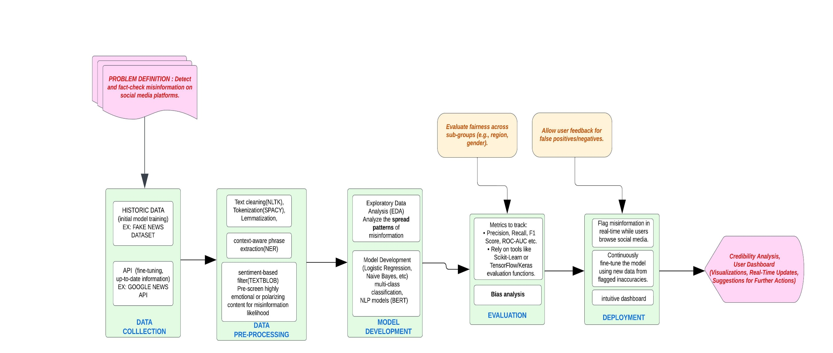
FLOW GRAPH

Slide 4
HISTORICAL DATASET
LIAR dataset - Kaggle
Train,test,validate csv- google collaboratory
NLP : TfidfVectorizer, textblob, sentiment analyzer etc
ML ALGORITHM : Linear Regression

Slide 5
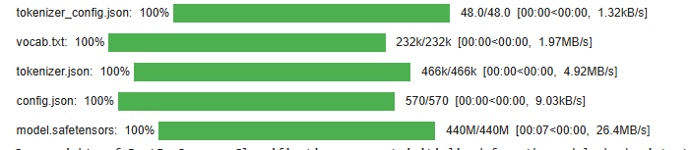
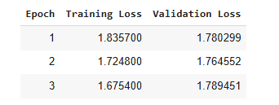
Bert

Slide 6
API DATA
For Real Time Monitoring
Google News API (Date - 1-10 January 2025, Location - India)
BBC News Feed Uk (http://feeds.bbci.co.uk/news/rss.xml)

Slide 7
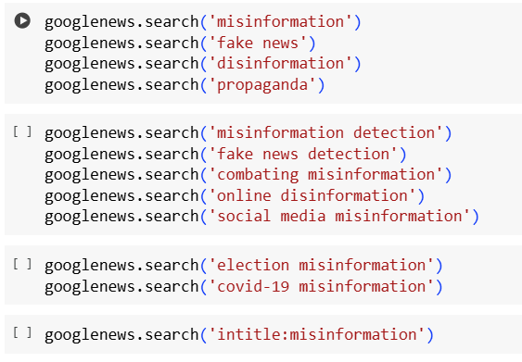
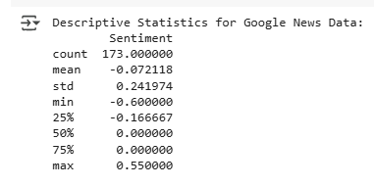
(mean = -0.07) and the clustering around neutrality suggest that the dataset contains many neutral or slightly negative articles, which might align with misinformation themes

Slide 8
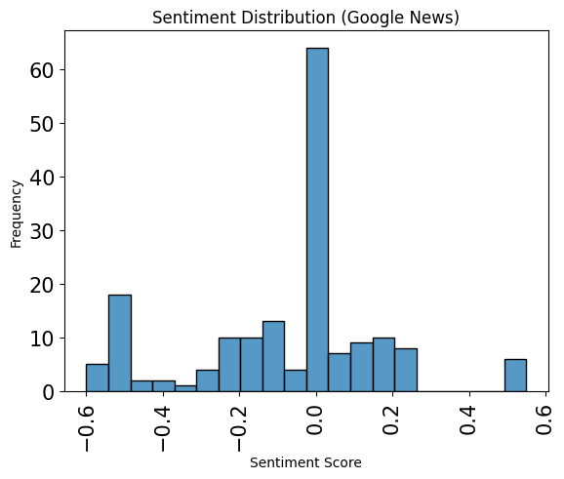
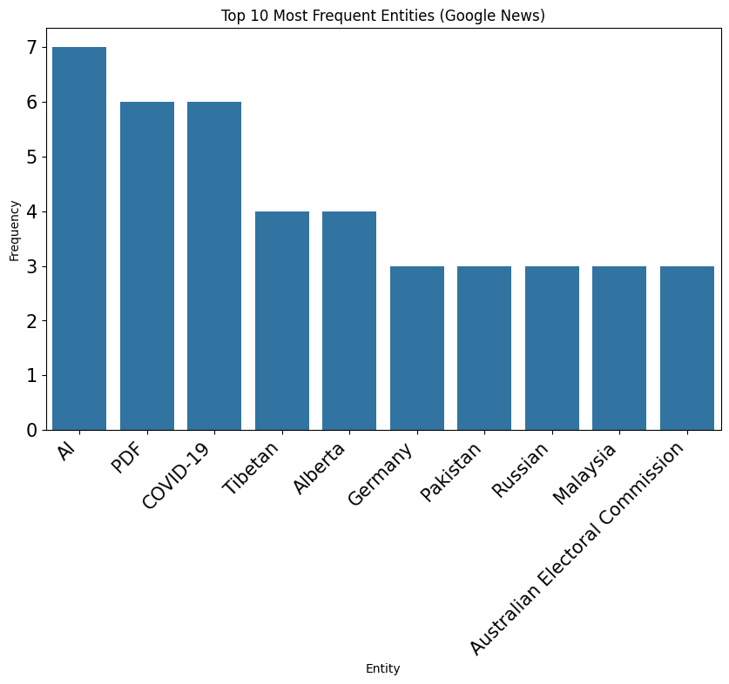
The sentiment score for neutrality is highest in Google news data
The most frequent entities occurring is AI followed by PDF and covid-19

Slide 9
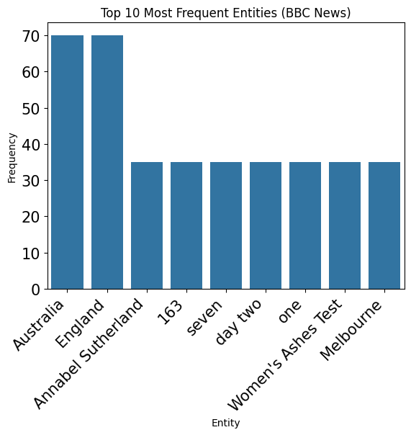
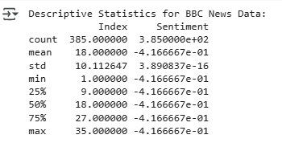
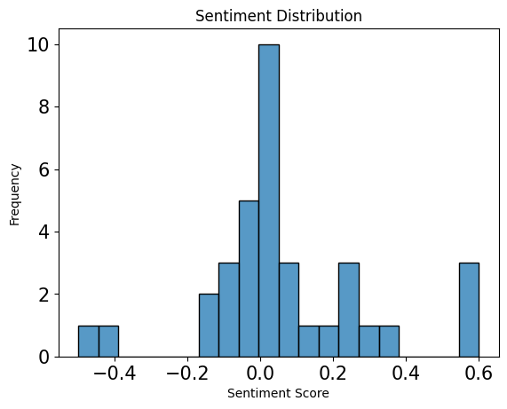
For BBC News Australia and England are the most common occurring entities in terms of frequency
Where as, Descriptive statistics shows positive standard deviation with 75% evaluation.

Slide 10
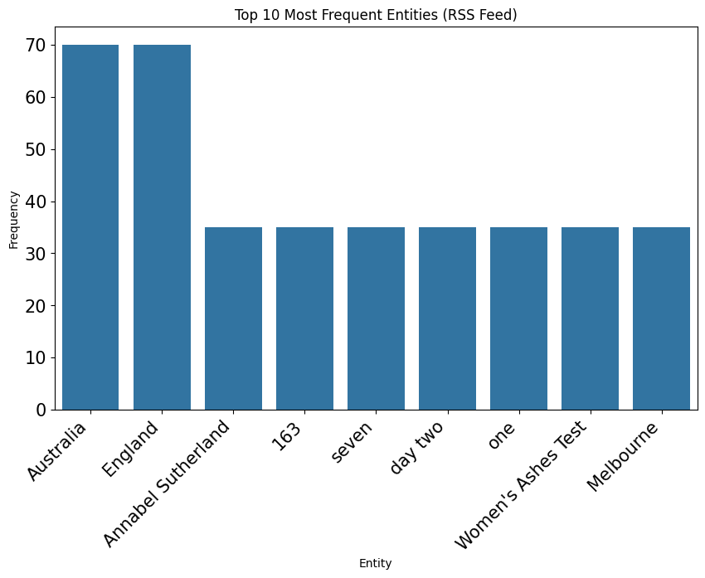
RSS feed describes Australia and England as most frequent occurring entities in the latest news.
Rest of the words from Annabel Sutherland till Melbourne are the 2nd most occurring which have the same frequency

Slide 11
DEPLOYMENT
FLASK (Local deployment session)
NGROK (External sources)
To expose a locally running web server
Weights and Biases / Hugging Face (Real time Monitoring)
For Evaluation
!python app.py to start the Flask API in Colab.

Slide 12
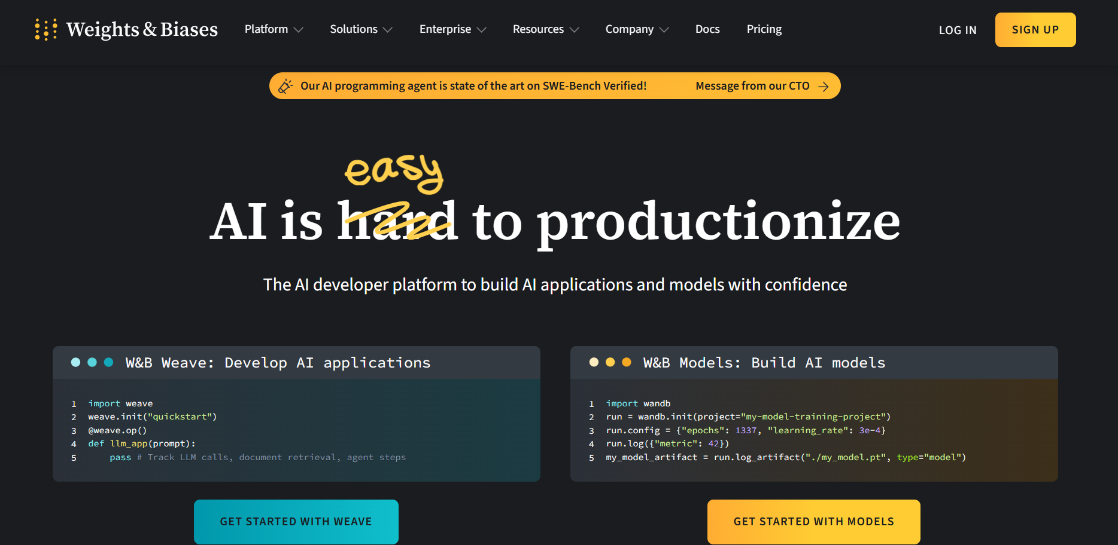

Slide 13
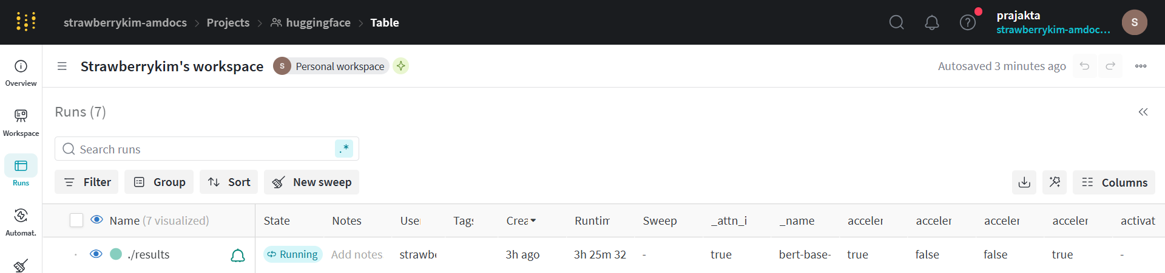
HUGGING FACE RESULTS

Slide 14
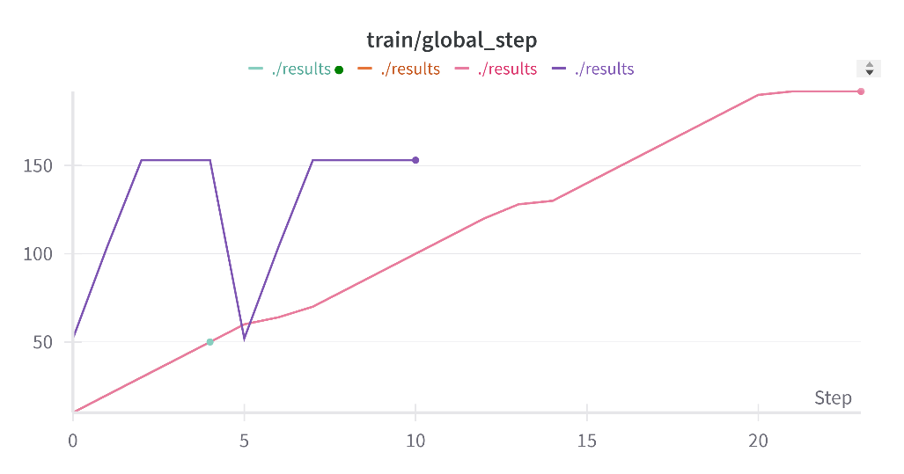
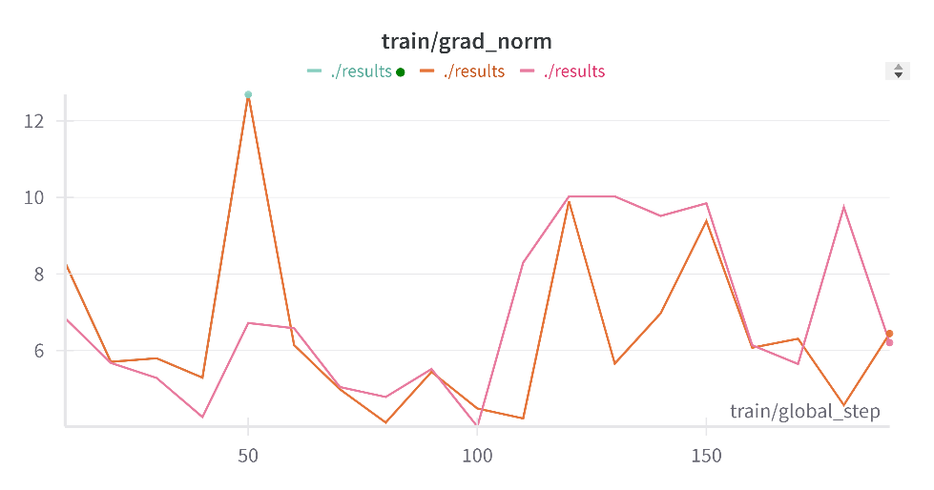
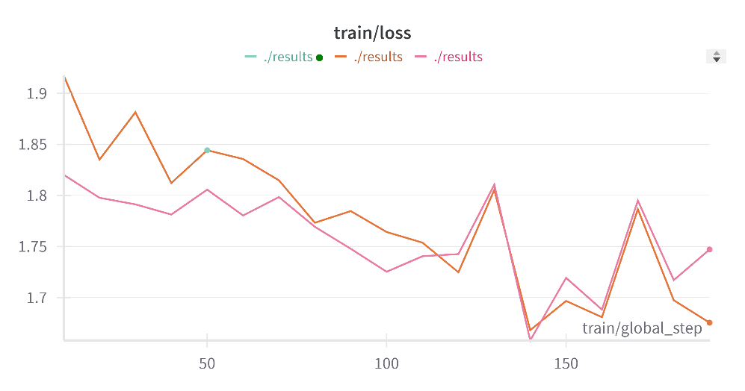

Slide 15
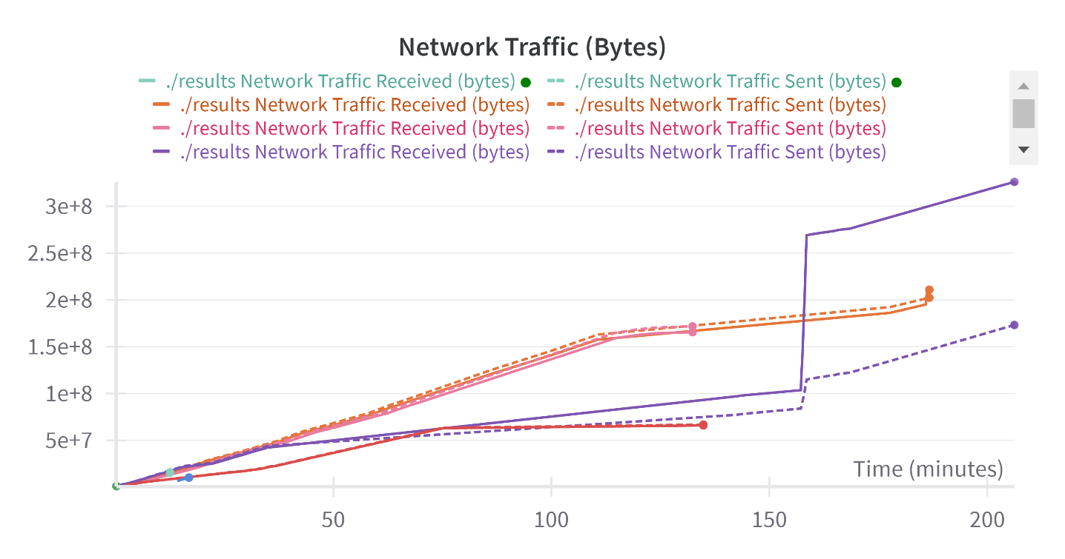
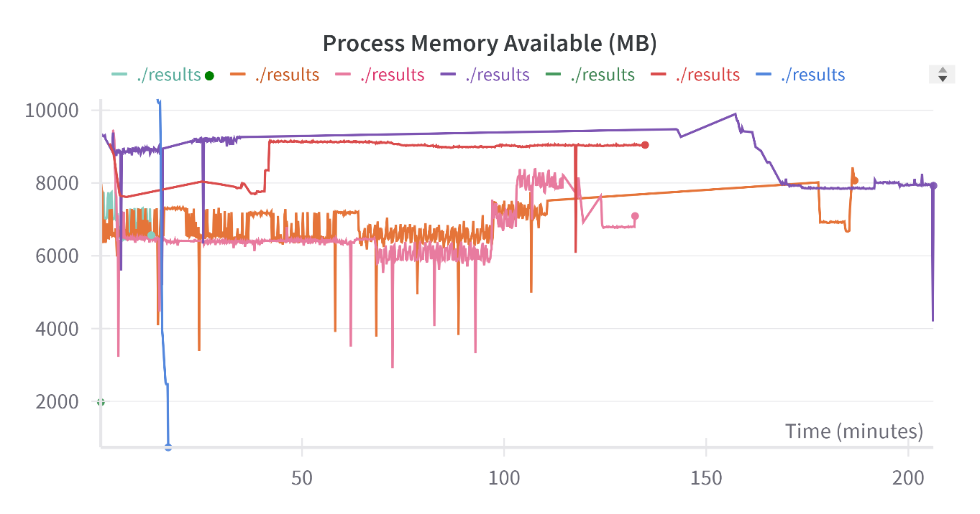

Slide 16
FUTURE SCOPE
Increase Accuracy of model with ML-NLP Algorithms and Tasks
External Sources Deployment and MLFLOW Monitoring for Experiments
Dynamic fact checking with Web interface connection
Increase accuracy for Dynamic Dashboard

Slide 17
THANK YOU

